Slide 1

HR ANALYTICS
PRESENTED BY GROUP 5

Slide 2





AGENDA
KPIs and Insights
Conclusions and suggestions
Introduction
Objective

Slide 3

INTRODUCTION
Human Resources (HR) Analytics, also known as People Analytics, is a data-driven approach to managing and optimizing an organization's workforce.
HR Analytics aims to transform HR practices from traditional, intuition-based decision-making to more evidence-based, strategic decision-making processes.
This is made possible with the help of analytical tools like MS Excel, Power Bi, etc. and analytical professionals.

Slide 4
OBJECTIVE
PERFORMANCE OPTIMIZATION
WORKFORCE PLANNING
EXPERIENCE ENHANCEMENT
RETENTION AND TALENT
MANAGEMENT

Slide 5
KPIS
Average attrition rate for all Departments.
Average Hourly rate of Male Research Scientists.
Attrition rate vs Monthly Income Stats.
Average working years for each Department.
Job role vs Work life balance.
Attrition rate vs Year since last promotion relation.

Slide 6
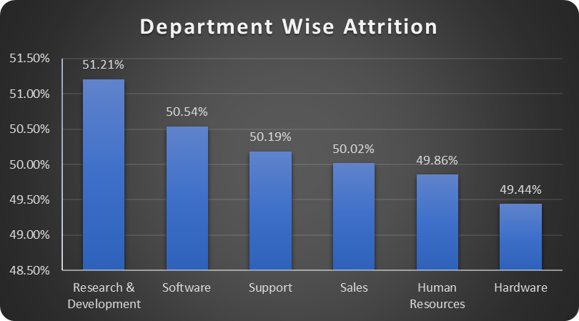
Attrition rate for all department
Reasons
Average monthly income stands at 25,796 which is the least amongst all.
Average Daily Rate is 794 which is again the least amongst all.

Slide 7

Average hourly rate of male research scientists
Male Research Scientists
Average Hourly Rate is
114.45 which is the 8th as per all departments.

Slide 8

Attrition rate vs Monthly income stats
Department with the lowest average of monthly income has the highest attrition rate.

Slide 9
Average working years for each department
Software department has the best average for working years, with above 20,863 employees rating above 3 for work-life balance.

Slide 10
Job role vs Work-life balance
A Research Scientist experiences the best work-life balance amongst all.

Slide 11
Attrition vs Years since last promotion
Max number of employees leave the company within the span of 1st 10 years with attritions coming at a rate of nearly 80%

Slide 12

Conclusions and Suggestions
To conclude the company has pretty much an evenly distributed performance across departments and job roles.
However attritions are a major concern for the company as overall attrition rate is 50.21%, with overall job satisfaction at 2.4 which is an alarming insight for the HR team.
Suggestions would be more employee benefits. This could come to rescue for an exponentially high attrition rate and a below average job satisfaction index.

